Slide 1
Performance Nutrition
Centerville Cross Country Sam Marasek RD,LD

Slide 2
Outline
Nutrition 101
Nutrients of importance
Myth busting
Meal planning
Running in college
Q & A
Notes:
intro

Slide 3
Keywords
-CHO: carbohydrates
-kcal: Calorie
-glycogen: glucose stored in the liver and muscles
-glucose: C₆H₁₂O₆
-1 lb = 2.2 kg
-hemoglobin: protein responsible for transporting oxygen through bloodstream, to working muscles
-DRI: dietary reference intake
-BMR: basal metabolic rate
-TUL: tolerable upper limit

Slide 4
Nutrition 101
Macronutrients
Carbohydrates (4 kcal/g)(60-65%)
-body’s preferred source of energy
-sugars, starches and fibers
-metabolic endpoint is glucose
Apply it→ whole grains, except prior to physical activity
Rule of : Consume no more than 100kcal/hr, before an event.

Slide 5
Nutrition 101
Macronutrients
Protein (4 kcal/kg)
-Structure, function and regulation of the body’s tissues
-Unlike carbohydrates and fat, protein contains nitrogen
-Endurance athletes should aim for 1.2-1.4g/kg of body wt
i.e. 120lb runner = 120lb/2.2 = 54.5kg
54.5kg x 1.2g = 65g of protein
54.5kg x 1.4g = 76g of protein
Apply it→ Have a carbohydrate/protein snack post workout, unless you’re having a meal w/i the next 90 minutes.
Rule of : carb to protein ratio of 4 to 1.
Notes:
Muscle tissue, hormones, enzymes

Slide 6
Nutrition 101
Macronutrients
Fat (9 kcal/g)
-energy source, necessary for nutrient metabolism, hormone synthesis
-partial fuel source during low to moderate intensity exercise
-saturated fat v. unsaturated fat
Apply it→ consume a healthy fat with foods containing Vitamin A,D,E or K
Rule of : at least 10% of total kcal should come from fat
Notes:
10-20%, as an athlete. For your average American, 20-35%.

Slide 7
Nutrition 101
Micronutrients: substance needed in trace amounts, for normal growth and development
Vitamins: organic compound (contains carbon)
Minerals: inorganic compound (no carbon)
*Water: category all its own...
Notes:
1ml/1kcal, urine color, don’t depend on thirst. Be sure to touch on hydration.

Slide 8
Nutrients of Importance
Iron
-component of hemoglobin, making it instrumental in transporting oxygen throughout the body
-Therefore, iron deficiency anemia limits aerobic endurance
-Athletes at greater risk of anemia: athletes with energy restricted diet, female athletes with heavy menstrual losses, GI blood loss, “heavy sweaters”, hemolysis by foot impact…
-Lab “gold standard” is serum ferritin
Apply it→ consume vitamin C and iron together
Rule of : 8mg/d for men and 18mg/d for women

Slide 9
Nutrients of Importance
Calcium
-99% is found in bones and teeth; ionic calcium is essential for ion transport across cell membranes
-vitamin D aids in the absorption of calcium
-DRI: 1300mg ages 9-18
Apply it→ one 8oz glass of 1% milk contains 305mg of calcium
Rule of : 4 servings of dairy/day
Notes:
Calcium and vitamin D work together...remember vitamin D is fat soluble vitamin, that is why you will only find whole milk with Vitamin D. Milk, yogurt, cheese. Dark leafy greens contain calcium but in such small amounts/such low bioavailability, not a good idea to focus on them for calcium intake.

Slide 10
Myth Busting
“Eating too much ______ will make you fat.”
-kcals consumed>kcal expenditure = wt gain
-kcals consumed<kcal expenditure = wt loss
http://www.cnn.com/2010/HEALTH/11/08/twinkie.diet.professor/
-variety of factors influence BMR...

Slide 11
Myth Busting
“It’s important to eat pasta the night prior to race day.”
Research has found that when endurance athletes carb load, fatigue is delayed and their performance improves in events lasting more than 90 minutes.
-Eat what works best for you
-Focus on the big picture

Slide 12
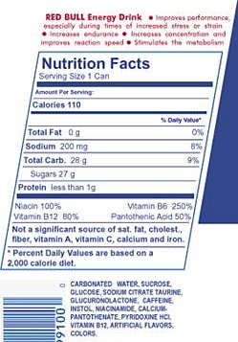
Myth Busting
“Energy drinks improve athletic performance.”
-Most contain blend of caffeine, sugar, B vitamins
and taurine
-80mg caffeine; TUL 400mg/day
-1000mg taurine; TUL 3000mg/day
*taurine is an amino acid found primarily in blood, heart and liver

Slide 13
Meal Planning
Weight management
-Rather than focusing on a number, focus on weight related to performance
-Variety of ways to calculate energy needs:
Bod Pod, direct calorimetry, indirect calorimetry, kcal/kg, kcal/lb, Mifflin St. Jeor equation, Ireton-Jones equation, Estimated Energy Expenditure Prediction Equations at four physical activity levels

Slide 14
Meal Planning
Weight management
-Factors affecting BMR:
Age, sex, muscle v. fat free mass, body size, hormonal status, thermic effect of food (TEF), physical activity, genetic predisposition
-1lb of body mass = energy equivalent of 3500kcal
*keep in mind when establishing wt goals
Notes:
**grocery shopping**

Slide 15
Meal Planning
Frosted flakes w/ 2% milk Oatmeal w/ 1% milk
Orange juice Low fat yogurt & fresh fruit
Turkey/cheese sandwich on white bread String cheese
Pretzels
Fruit snacks Turkey/hummus on wheat bread
G2 Carrots
Granola bar
Granola bar w/ 8oz water
G2 or small banana
Penne w/ meat sauce
Tossed salad w/ ranch dressing WW pasta w/ meat sauce Breadstick Salad w/ vinaigrette
Ice cream Ice cream
Notes:
Should I put serving sizes??? Insert blurb about “mom” meals

Slide 16
Collegiate Running
Opportunities
-NAIA
-NCAA III
-NCAA II
-NCAA I

Slide 17
Collegiate Running
Pros
-help pay for school
-improve/run faster
-travel
-make friends
-free gear/per diem
-access to top notch facilities
-life lessons
Notes:
Partial or full, academics>athletics, (CA,PA,NY,IA,MO,AR,FL,OK,NE,IN,OH,KY,OR) highlights: oregon, NYC, palo alto.

Slide 18
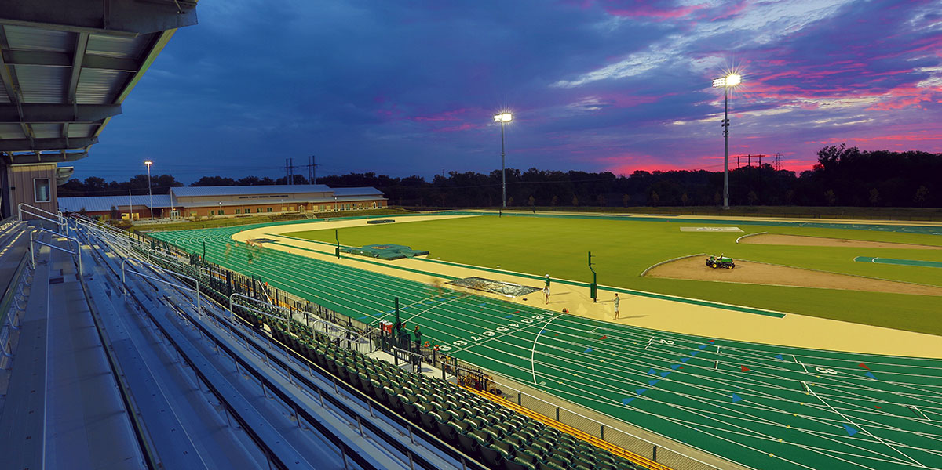
Collegiate Running

Slide 19
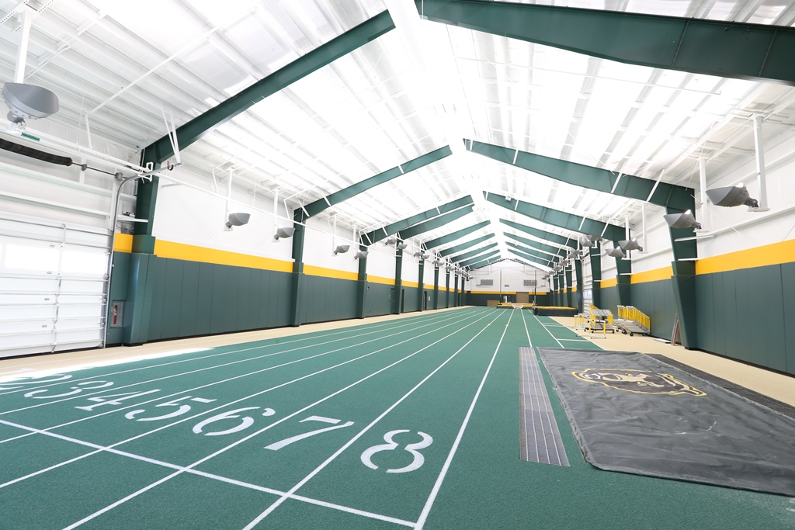
Collegiate Running

Slide 20
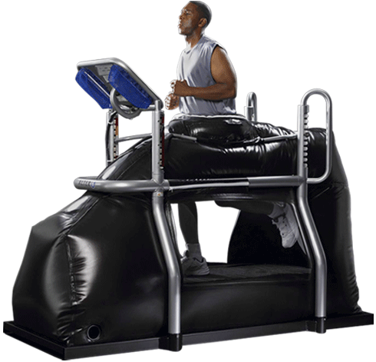
Collegiate Running

Slide 21
Collegiate Running
Cons
-time consuming
-no “college experience”
-some professors aren’t understanding
-requires dedication to be successful
-injury
-new coach
Notes:
Practice “up to 20hrs/wk”, no sorority/frat, take tests early, doing all the little things right, do you see yourself at that school if something happened to your athletic career?, treat your visits like an interview. Where do you see the program in 5 years? Where do you see yourself in five/ten years? Ask current team what they think?

Slide 22
Resources
CPSDA- collegiate and professional sports dietitian association
Letsrun.com- forum(s) related to all things running
Runnersworld.com- popular running magazine
USATF- United States of America Track & Field
NCAA- National collegiate athletic association
NAIA- National association of intercollegiate athletics
Eatright.org- Academy of nutrition and dietetics
SCAN- sports, cardiovascular and wellness nutrition
ISSN- international society of sports nutrition
Redbull.com- nutrition info for product
http://sampatty64.wixsite.com/mysite

Slide 23
Questions ?

